Slide 1
Autonomous Robo Car
Dept. of Computer Science and Engineering
SRCOEM
Under Guidance of
Mr. Ram Hablani
Group Members
Anshul Sarda (45)
Jogendra Shekhawat(53)
Kaustubh Risodkar (56)
Kshitij Madan(57)
Pratik Upacharya(60)

Slide 2
Problem Definition
Developing an autonomous robo-car which can navigate in a real time environment .

Slide 3
The basic aim is to attach a camera to a laptop or to any smart device which will be placed on a servo motor car. The device will be programmed through MATLAB/OPEN CV in such a way that it will be able to process the images and estimate the directions to travel on its own. The project specifically aims at the following aspects:
Designing an autonomous robo-car that can work on its own.
Making the car navigate through real time obstacles.

Slide 4
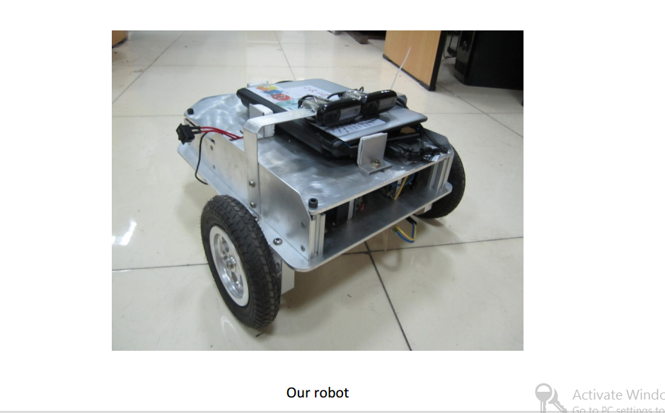
Our proposed robot

Slide 5
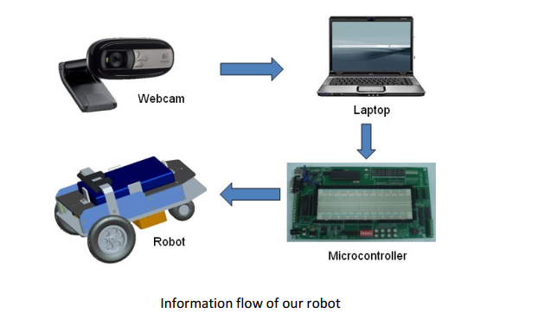

Slide 6
Design Phase Details :
Software Design
Hardware Design
Embedded System Programming
Integration of Software and Hardware

Slide 7
Software Design
Requirements :
Tools:
1) Microsoft Visual Studio
2) OpenCV (library)
3) GIT (Version Control System)
4) External Webcam

Slide 8
Language to be used :
C++ :
Why C++?
It’s fast
Close to system
Object Oriented
OpenCV is built on C++

Slide 9
OOP Design Of Program
There basically four classes under Software Part:
Vehicle Class
Calculation Class
Obstacle Class (Image Processing)
Main Class (Implementation)
Other than this , there are other subclasses .

Slide 10
Vehicle Class
Includes Following methods :
Start Vehicle
Stop Vehicle
Get Speed Of Obstacle
Get Distance of Obstacle
Send Control Message through COM PORT
ex: R0305 Right 30 degree for 5sec.

Slide 11
Obstacle Class
Methods:
Detect Obstacle
Get width of Obstacle
Get Height of Obstacle
Detect Red Obstacle

Slide 12
Calculation Class
Methods:
Rotation Angle
Time of Rotation

Slide 13
Main Class
This class will contain algorithm for implementation of entire program .
We will describe the algorithm after getting information about Hardware design .

Slide 14
Hardware Design
Requirements :
Programming language :
Python
Q . Why Python ?
1) Compatible with Raspberry Pi

Slide 15
Hardware
Raspberry Pi Model B+
Two Servo Motor (360 rotation)
12v 7AH battery
Ultrasonic Sensor
USB to Serial Cable
Wheels , Chassis , Wires , LED etc

Slide 16
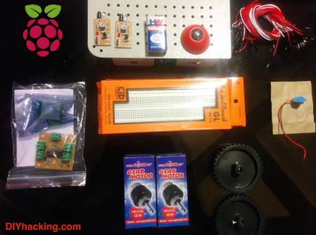

Slide 17
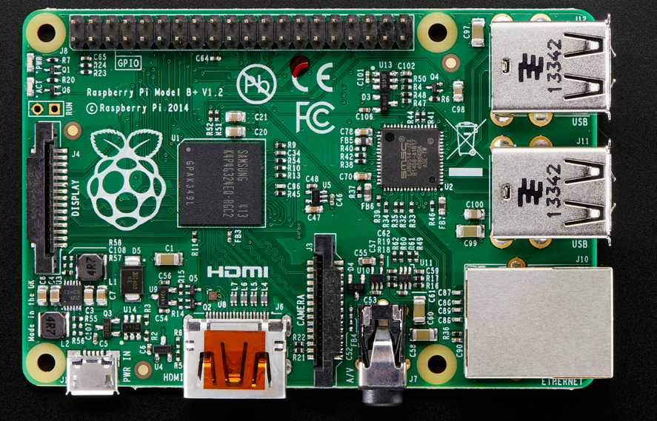

Slide 18
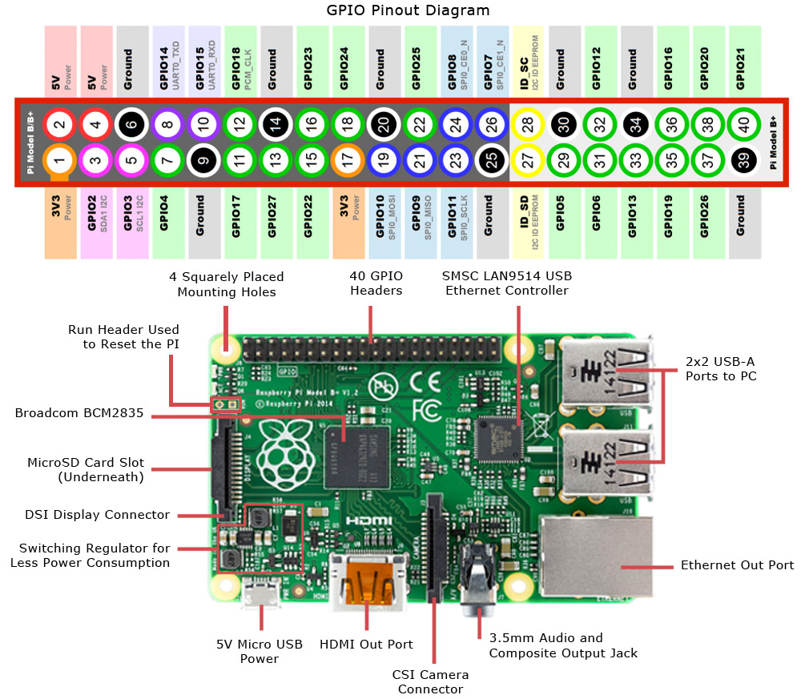

Slide 19
Design Of Raspberry Pi Program
It consist of two classes :
Motor Class
Ultrasonic Sensor Class

Slide 20
Motor Class
Methods :
Control Angle
Control Speed

Slide 21
Ultrasonic Sensor
Methods
Send Signal (Echo signal)
Receive Signal
Calculate Time Difference
Calculate Distance
Send Distance through COM port

Slide 22
Working And Implementation
1) Working of Ultrasonic Sensors
2) Working of Servo Motors
3) Image Processing Algorithms
4) Integration Of Software and Hardware and Final Algorithm .

Slide 23
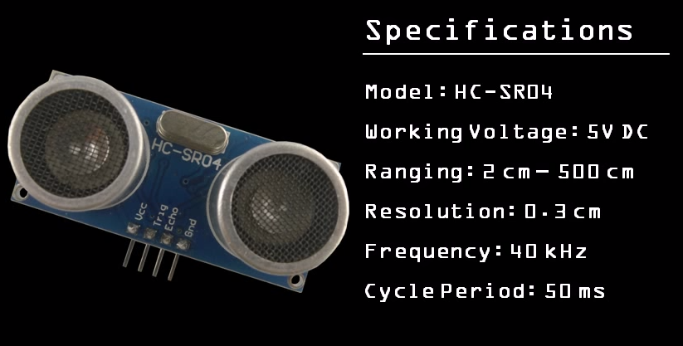
Ultrasonic Sensor Working

Slide 24
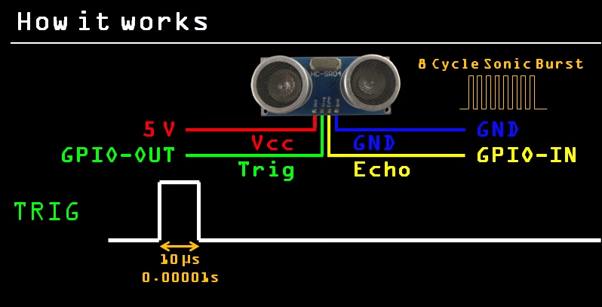

Slide 25
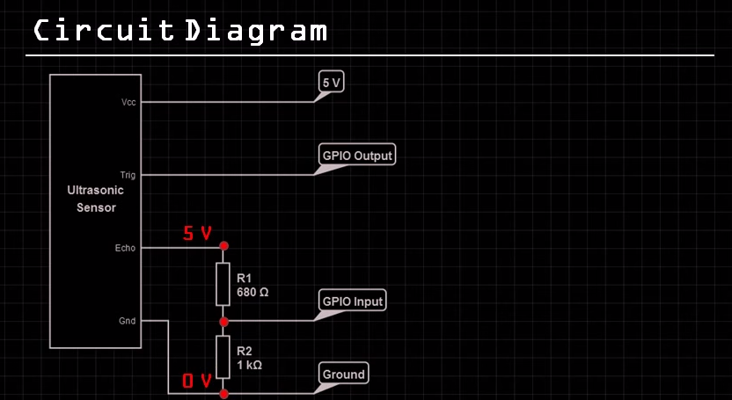

Slide 26
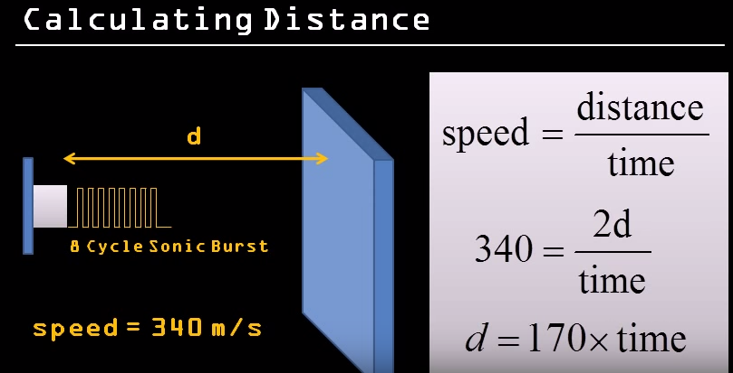

Slide 27
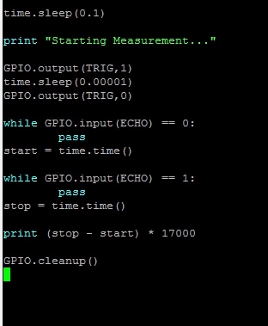

Slide 28
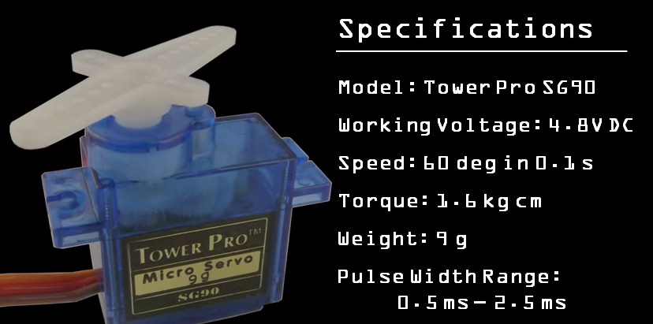
Working Of Servo Motors

Slide 29
Servo Motor :
Three wires
Positive
Negative
Signal
0.5 For 0 degree
1.5 for 90 degree
2.5 for 180 degree and so on .

Slide 30
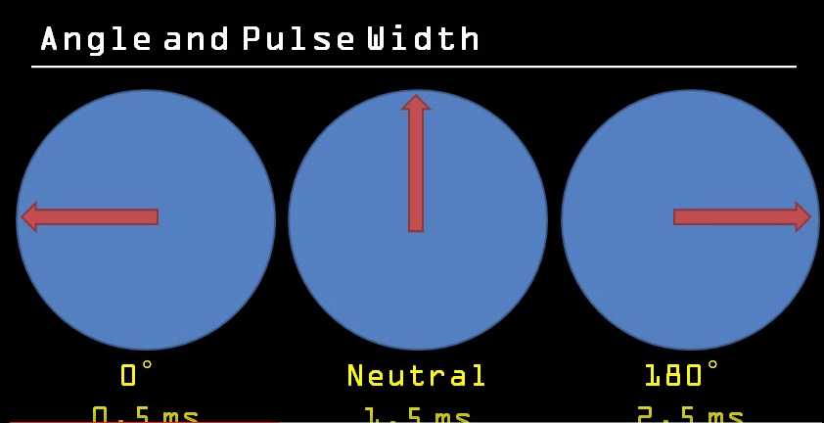

Slide 31
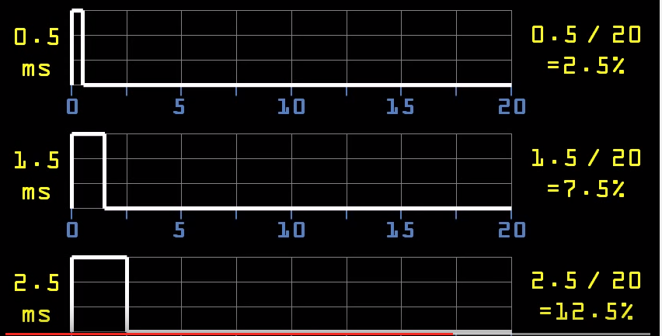

Slide 32
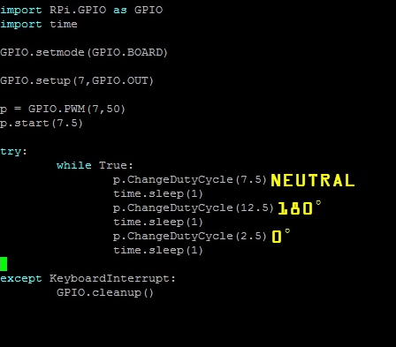

Slide 33
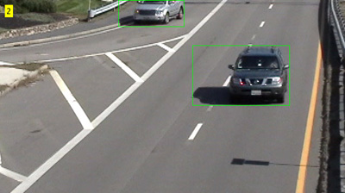
Image Processing

Slide 34


Slide 36
Main Class
{
Create object of Vehicle (v) , Obstacle (o) , Calculation(C) class
delay(20sec)
v.startVehicle(speed, angle)
while(!o.redObstacle){
if(o.detectobstacle){
w = o.getWidth();
h = o.getHeight();
d = o.getDistance();
s = o.getSpeed();
angle = c.calAngle(w,d,s);
time = c.timeOfRotation(angle,d,s);
v.sendSignalToRasp(time,angle);
}
}
v.stopVehicle();
}

Slide 37
Raspberry Pi
{
Create object of Motor(M) , Ultrasonic Sensor (US), Serial Communication (SC)
while(1){
x = sc.waiting()
if(x == true){
break;
}
}
while(1){
String input = sc.getSignal();
/*
* Types of signals
Type 1 : "1+(L,R)+Angle+Speed";
ex: "1+L+30+20"
Type 2 : Send Distance of object
Type 3 : Stop the car
*/
if (type ==1 ){
direction = getDirection(input)
angle = getAngle(input)
speed = getSpeed(input)
m.setSpeed()
m.setDirection()
m.setAngle()
}

Slide 38
if(type == 2){
start = us.sendSignal()
stop = us.recieveSignal()
dist = us.calculateDistance(start,stop);
us.sendDistanceToComputer(dist)
}
if(type == 3)
{
direction = getDirection(input)
angle = getAngle(input)
speed = getSpeed(input)
time = getTime(input)
m.setSpeed(speed)
m.setDirection(direction)
m.setAngle(angle)
delay(time)
// reverse the position
m.setSpeed(speed)
m.setDirection(direction)
m.setAngle(180-angle)
}
}
}

Slide 39
References
1) For Obstacle Detection :
http://www.mathworks.com/help/vision/examples/detecting-cars-using-gaussian-mixture-models.html
2) Basic Of Raspberry Pi
http://www.instructables.com/id/Building-robots-with-Raspberry-Pi-and-Python/
3) Hardware
3.1)http://www.robotshop.com/en/microcontrollers.html
3.2) https://www.protocentral.com/34-motors?orderby=price&orderway=desc
Etc
3.3) http://www.modmypi.com/shop
3.4)http://www.rhydolabz.com/index.php?main_page=index&cPath=197&zenid=4b5a38dc64f759508730d971af3cbedb

Slide 40
Camera integration
http://blog.dawnrobotics.co.uk/2014/01/using-dagu-mini-driver-build-raspberry-pi-camera-robot/
5) Youtube Videos :
For Servo Motor
1)https://www.youtube.com/watch?v=ddlDgUymbxc
For Ultrasonic sensor
2) https://www.youtube.com/watch?v=xACy8l3LsXI
6) Research Papers :
6.1)https://www.kpmg.com/US/en/IssuesAndInsights/ArticlesPublications/Documents/self-driving-cars-next-revolution.pdf
6.2)http://www.rand.org/content/dam/rand/pubs/research_reports/RR400/RR443-1/RAND_RR443-1.pdf
7) For languages and Image Processing
http://www.tutorialspoint.com/

Slide 41
Thank You

